Slide 1
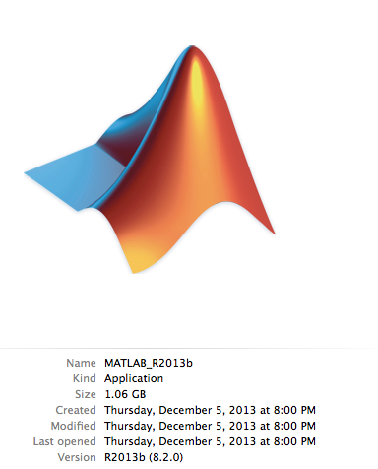
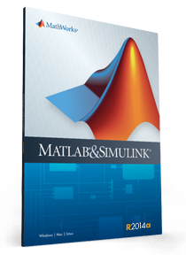

A Brief introduction to MatLAB
https://www.mathworks.com ($50 - $99 for students)
http://wiscsoftware.wisc.edu/wisc/school.asp?institution=1024
($93)

Slide 2
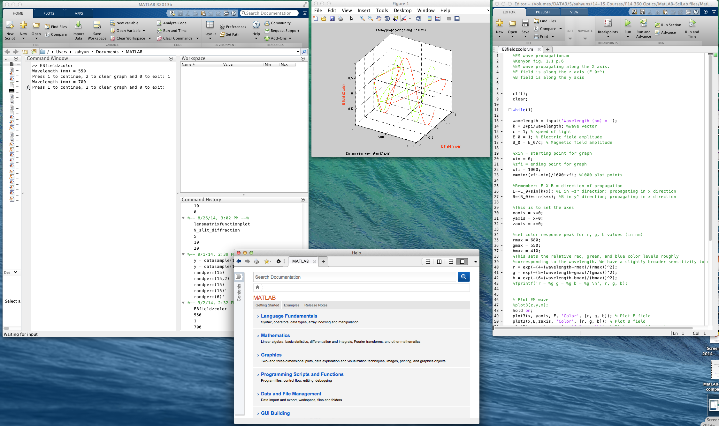
This is what MatLAB looks like:
Graphics Window
Script Window
Command Window
Help Window

Slide 3
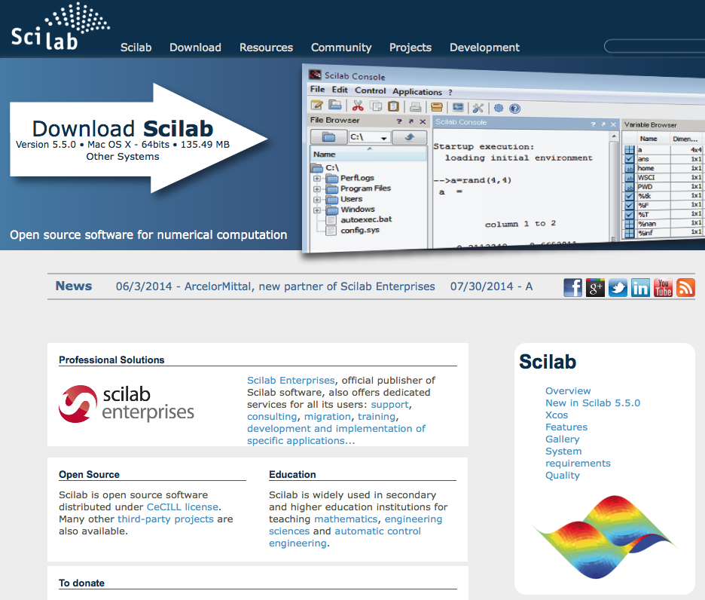
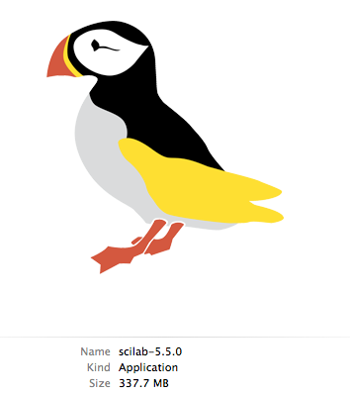
An alternative is SciLAB
http://www.scilab.org (FREE!!)

Slide 4
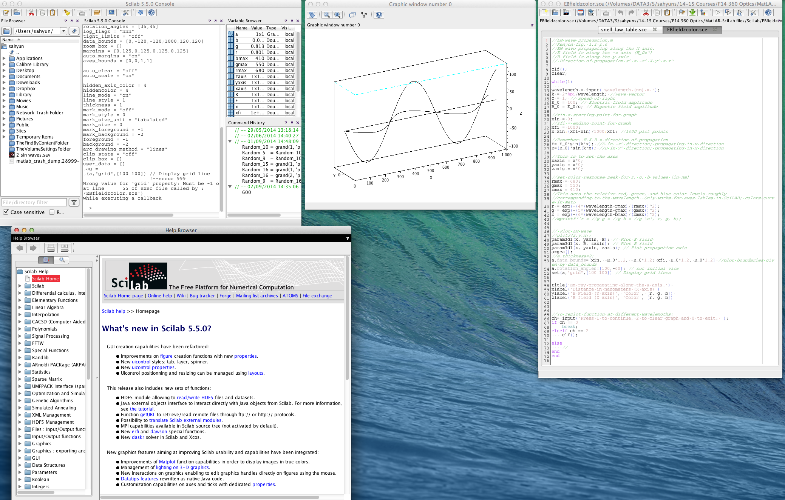
Command Window
Graphics Window
Script Window
Help Window

Slide 5


Key differences between MatLAB and SciLAB
 | MatLAB | SciLAB
Price | $100 (student) | FREE, easy to install
Comments | % | //
Pi | pi | %pi
Functions | Separate files | In script
Graphing | More color control | Some functions are different.
Help support | Better help pages – more understandable examples | Better Wiki pages – more examples

Slide 6
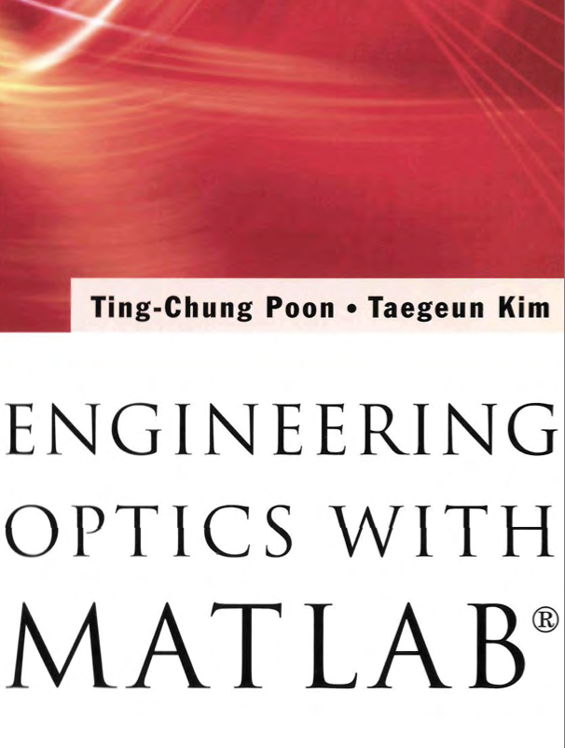
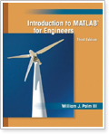
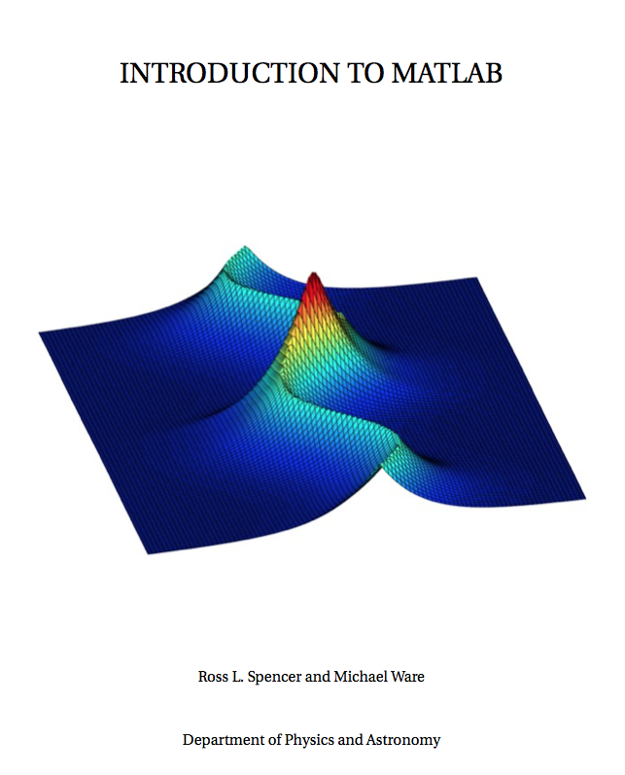
Resources for doing things with MatLAB
Introduction to MATLAB for Engineers, 3rd Edition
Available at UW Whitewater Main Collection, 3rd Floor (QA297 .P33 2011)
Available at UW Whitewater Main Collection
Introduction to MATLAB available at http://www.physics.byu.edu/faculty/spencer/physics430/matlab.pdf

Slide 7

PowerPoint to accompany
Introduction to MATLAB
for Engineers, Third Edition
William J. Palm III
Chapter 1
An Overview of MATLAB®
Copyright © 2010. The McGraw-Hill Companies, Inc.
Slides from https://www.mathworks.com/

Slide 8
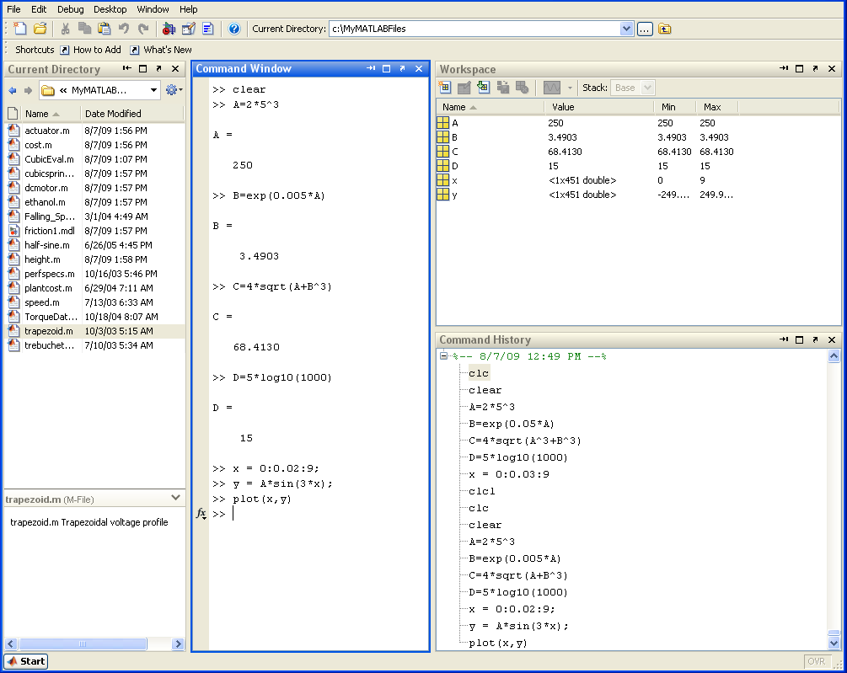
The Default MATLAB Desktop, Fig. 1.1-1, page 5
1-1

Slide 9
1-2
Entering Commands and Expressions
• MATLAB retains your previous keystrokes.
• Use the up-arrow key to scroll back back through the commands.
• Press the key once to see the previous entry, and so on.
• Use the down-arrow key to scroll forward. Edit a line using the left- and right-arrow keys the Backspace key, and the Delete key.
• Press the Enter key to execute the command.

Slide 10
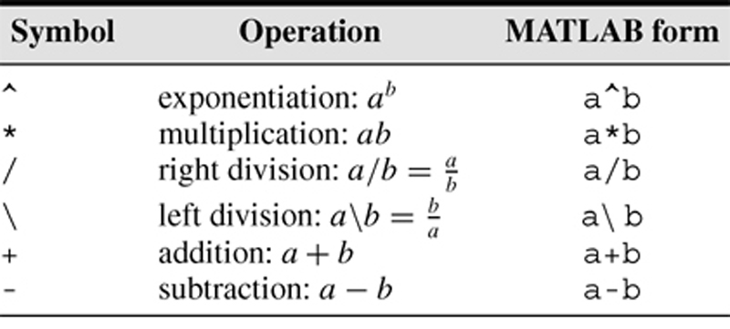
1-3
Scalar arithmetic operations
Table 1.1–1, page 8
Note 1: .* and ./ multiplies and divides elements of matrices
[1 2 3] .* [4 5 6] = [4 10 18]
Note 2: EVERYTHING is a matrix.

Slide 11
1-4
Try the following examples:
>> 8/10
ans =
>> 5*ans
ans =
>> r=8/10
r =
>> r
r =
>> s=20*r
s =
>> a = [ 1 2 3]
a =
>> b = [4 5 6]
b =
>> a*b
>> a.*b
ans =
>> a*b’
ans =
>> a’*b
ans =

Slide 12
1-4
Try the following examples:
>> 8/10
ans =
0.8000
>> 5*ans
ans =
4
>> r=8/10
r =
0.8000
>> r
r =
0.8000
>> s=20*r
s =
16
>> a = [ 1 2 3]
a =
1 2 3
>> b = [4 5 6]
b =
4 5 6
>> a*b
Error using *
>> a.*b
ans =
4 10 18
>> a*b’
ans =
32
>> a’*b
ans =
5 6
10 12
12 15 18

Slide 13
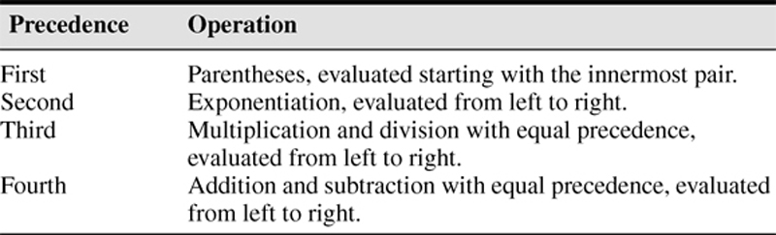
1-5
Order of precedence
Table 1.1–2, page 9

Slide 14
1-6
Examples of Precedence
>> 8 + 3*5
ans =
>> 8 + (3*5)
ans =
>>(8 + 3)*5
ans =
>>4^2­12­8/4*2
ans =
>>4^2­12­ 8/(4*2)
ans =
>> 3*4^2 + 5
ans =
>>(3*4)^2 + 5
ans =
>>27^(1/3) + 32^(0.2)
ans =
>>27^(1/3) + 32^0.2
ans =
>>27^1/3 + 32^0.2
ans =

Slide 15
1-6
Examples of Precedence
>> 8 + 3*5
ans =
23
>> 8 + (3*5)
ans =
23
>>(8 + 3)*5
ans =
55
>>4^2­12­8/4*2
ans =
0
>>4^2­12­ 8/(4*2)
ans =
3
>> 3*4^2 + 5
ans =
53
>>(3*4)^2 + 5
ans =
149
>>27^(1/3) + 32^(0.2)
ans =
5
>>27^(1/3) + 32^0.2
ans =
5
>>27^1/3 + 32^0.2
ans =
11

Slide 16
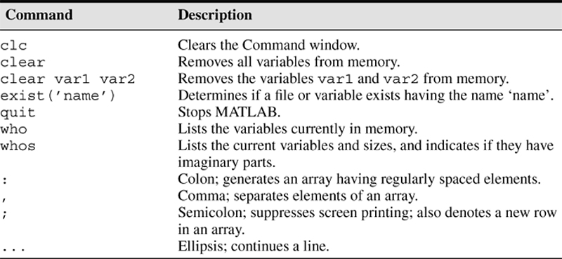
1-8
Commands for managing the work session
Table 1.1–3, Page 12

Slide 17
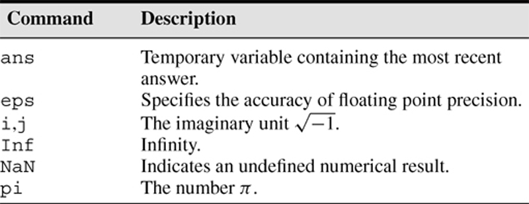
1-9
Special variables and constants
Table 1.1–4, Page 14

Slide 18
1-10
Complex Number Operations, Pages 14-15
• The number c₁ = 1 – 2i is entered as follows: c1 = 1­2i.
• An asterisk is not needed between i or j and a number, although it is required with a variable, such as c2 = 5 ­ i*c1.
• Be careful. The expressions
y = 7/2*i
and
x = 7/2i
give two different results:
y = (7/2)i = 3.5i
and
x = 7/(2i) = –3.5i.

Slide 19
1-12
Arrays
• The numbers 0, 0.1, 0.2, …, 10 can be assigned to the variable u by typing u = 0:0.1:10.
• To compute w = 5 sin u for u = 0, 0.1, 0.2, …, 10, the session is;
>>u = 0:0.1:10;
>>w = 5*sin(u);
• The single line, w = 5*sin(u), computed the formula
w = 5 sin u 101 times.
Note: the semicolon suppresses output! Try
x = 1:0.1:2
x = 1:0.1:2;

Slide 20
1-13
Array Index
>>u(7)
ans =
0.6000
>>w(7)
ans =
2.8232
• Use the length function to determine how many values are in an array.
>>m = length(w)
m =
101

Slide 21
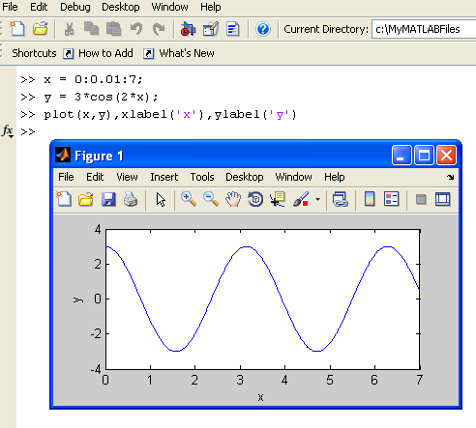
1-18
A graphics window showing a plot. Figure 1.3-1, page 24.
Activity: Plot a function

Slide 22
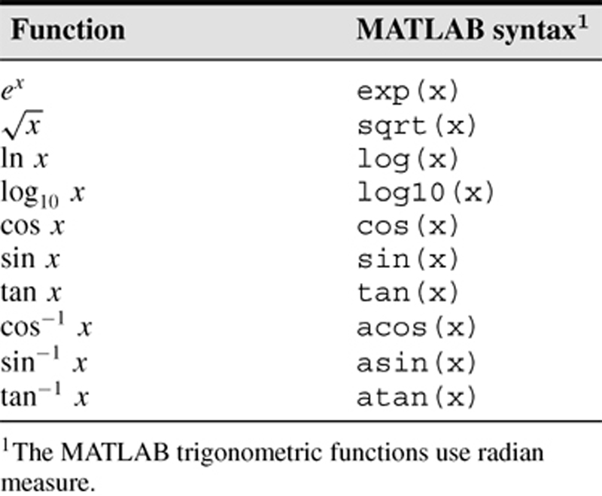
1-15
Some commonly used mathematical functions
Table 1.3–1, Page 21

Slide 23
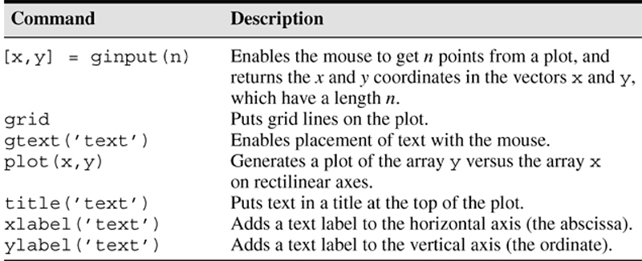
1-19
Some MATLAB plotting commands
Table 1.3–3, Page 25

Slide 24
1-16
When you type problem1,
1. MATLAB first checks to see if problem1 is a variable and if so, displays its value.
2. If not, MATLAB then checks to see if problem1 is one of its own commands, and executes it if it is.
3. If not, MATLAB then looks in the current directory for a file named problem1.m and executes problem1 if it finds it.
4. If not, MATLAB then searches the directories in its search path, in order,
for problem1.m and then executes it if found.

Slide 25
1-21
You can perform operations in MATLAB in two ways:
1. In the interactive mode, in which all commands are entered directly in the
Command window, or
2. By running a MATLAB program stored in script file. This type of file contains MATLAB commands, so running it is equivalent to typing all the commands—one at a time—at the Command window prompt. You can run the file by typing its name at the Command window prompt.

Slide 26
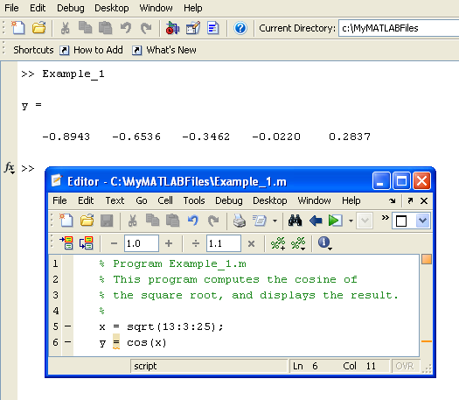
The MATLAB Command window with the Editor/Debugger open. Figure 1.4–1, Page 28
1-23

Slide 27
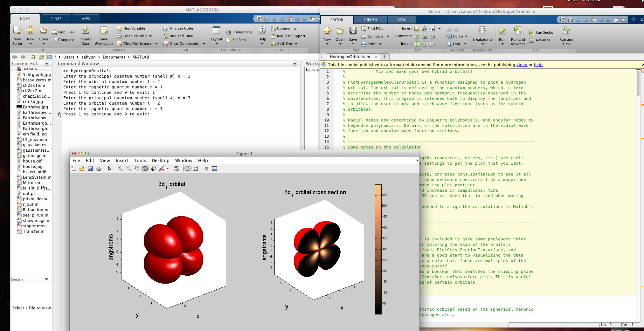
MatLAB Scripts (programs)
Download a script from: http://facstaff.uww.edu/sahyuns/matlab.php
Save with .m extension! Double-click to open,
CIick the Run arrow in the script window
“Add to path” in dialog box.
Look in the console window if script needs input values.

Slide 28
1-22
COMMENTS
The comment symbol may be put anywhere in the line. MATLAB ignores everything to the right of the % symbol. For example,
>>% This is a comment.
>>x = 2+3 % So is this.
x =
5
Note that the portion of the line before the % sign is executed to compute x.

Slide 29
1-27
Programming Style
1. Comments section
a. The name of the program and any key words in the first line.
b. The date created, and the creators' names in the second line.
c. Program description!
d. The name of every user-defined function called by the program.

Slide 30
Programming Style (continued)
Input section Include input data and/or the input functions and comments for documentation.
Calculation section
4. Output section This section might contain functions for displaying the output on the screen.
1-28

Slide 31
1-24
Keep in mind when using script files:
1. The name of a script file must begin with a letter, and may include digits and the underscore character, up to 63 characters.
2. Do not give a script file the same name as a variable.
3. Do not give a script file the same name as a MATLAB command or function. You can check to see if a command, function or file name already exists by using the exist command.

Slide 32
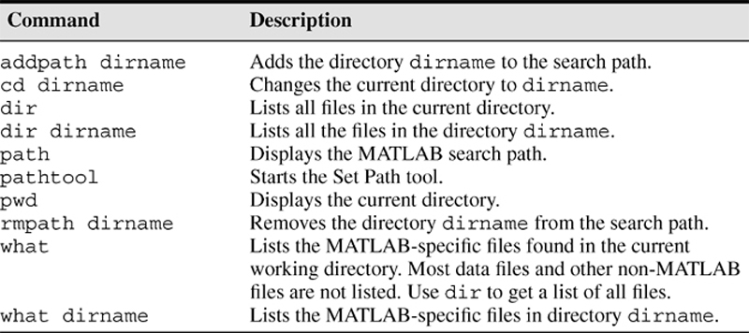
1-17
System, directory, and file commands
Table 1.3–2,Page 23

Slide 33
1-25
Debugging Script Files
Program errors usually fall into one of the following categories.
1. Syntax errors such as omitting a parenthesis or comma, or spelling a command name incorrectly. MATLAB usually detects the more obvious errors and displays a message describing the error and its location.
2. Errors due to an incorrect mathematical procedure, called runtime errors. Their occurrence often depends on the particular input data. A common example is division by zero.

Slide 34
1-26
To locate program errors, try the following:
1. Test your program with a simple version of the problem which can be checked by hand.
2. Display any intermediate calculations by removing semicolons at the end of statements.
3. Use the debugging features of the Editor/Debugger.

Slide 35
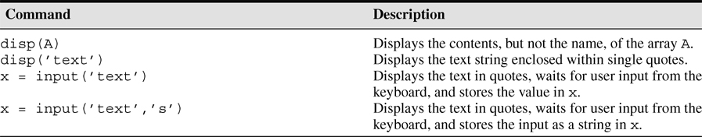
1-29
Some Input/output commands
From Table 1.4–1, Page 31

Slide 36
1-30
Example of a Script File, Page 32
Problem:
The speed v of a falling object dropped with no initial velocity is given as a function of time t by v = gt.
Plot v as a function of t for 0 < t < t_{final}, where t_{final} is the final time entered by the user.

Slide 37
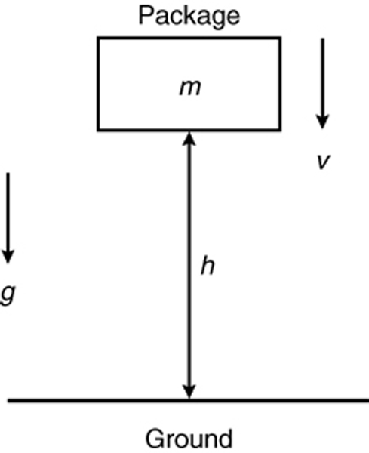
1-40
Sketch of the dropped-package problem.
Figure 1.6–1, page 41

Slide 38
Example of a Script File (continued)
% Program falling_speed.m:
% Plots speed of a falling object.
% Created on March 1, 2009 by W. Palm
%
% Input Variable:
% tfinal = final time (in seconds)
%
% Output Variables:
% t = array of times at which speed is % computed (in seconds)
% v = array of speeds (meters/second)
%
1-31

Slide 39
Example of a Script File (continued)
% Parameter Value:
g = 9.81; % Acceleration in SI units
%
% Input section:
tfinal = input(’Enter final time in seconds:’);
%
1-32

Slide 40
1-33
Example of a Script File (continued)
% Calculation section:
dt = tfinal/500;
% Create an array of 501 time values.
t = 0:dt:tfinal;
% Compute speed values.
v = g*t;
%
% Output section:
Plot(t,v),xlabel(’t (s)’),ylabel(’v m/s)’)

Slide 41
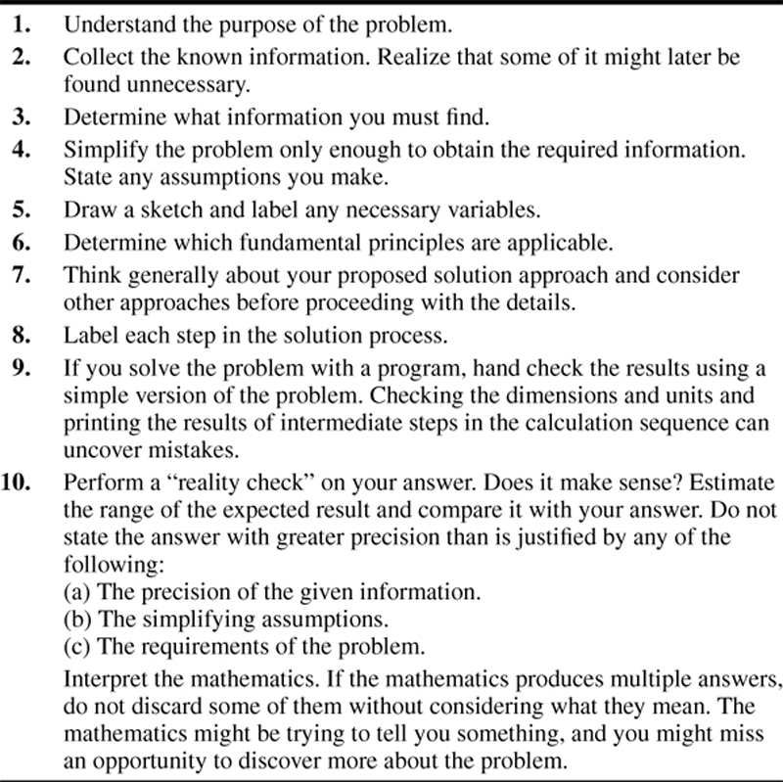
1-39
Steps in engineering problem solving
Table 1.6–1,
Page 39

Slide 42
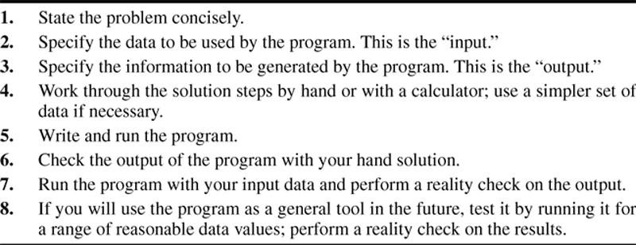
1-41
Steps for developing a computer solution
Table 1.6–2, page 42

Slide 43
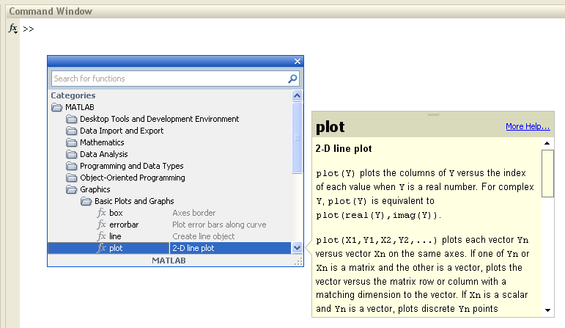
Getting Help From MATLAB:
The Function Browser after plot has been selected (Figure 1.5-1, page 33)
1-35

Slide 44
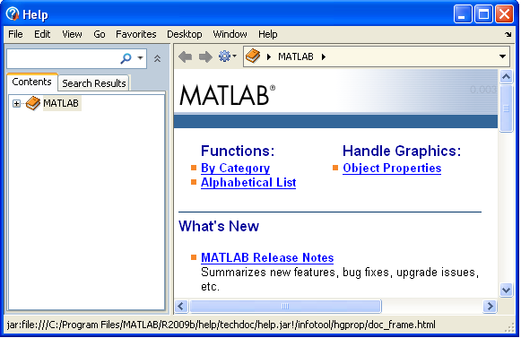
The MATLAB Help Browser
Figure 1.5-2, page 34
1-36

Slide 45
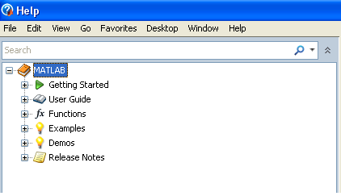
The Help Navigator
Fig. 1.5-3, page 35
1-37

Slide 46
MATLAB Help Functions,
From Table 1.5-1, page 38
help funcname: Displays in the Command window a description of the specified function funcname.
lookfor topic: Looks for the string topic in the first comment line (the H1 line) of the HELP text of all M-files found on MATLABPATH (including private directories), and displays the H1 line for all files in which a match occurs.
doc funcname: Opens the Help Browser to the reference page for the specified function funcname, providing a description, additional remarks, and examples.
1-38

Slide 47
1-14
Polynomial Roots, Page 20
To find the roots of x³ – 7x² + 40x – 34 = 0, the session is
>>a = [1,-7,40,-34];
>>roots(a)
ans =
3.0000 + 5.000i
3.0000 - 5.000i
1.0000
The roots are x = 1 and x = 3 ± 5i.

Slide 48
1-20
Linear Algebraic Equations, Page 26
6x + 12y + 4z = 70
7x – 2y + 3z = 5
2x + 8y – 9z = 64
>>A = [6,12,4;7,-2,3;2,8,-9];
>>B = [70;5;64];
>>Solution = A\B
Solution =
3
5
-2
The solution is x = 3, y = 5, and z = –2.

